Slide 1
Personal Imagery Through Attributes

Slide 2
Attribute
¹at·tri·bute noun \ˈa-trə-ˌbyüt\
an object closely associated with or belonging to a specific person, thing, or office <a scepter is the attribute of power>; especially : such an object used for identification in painting or sculpture

Slide 3
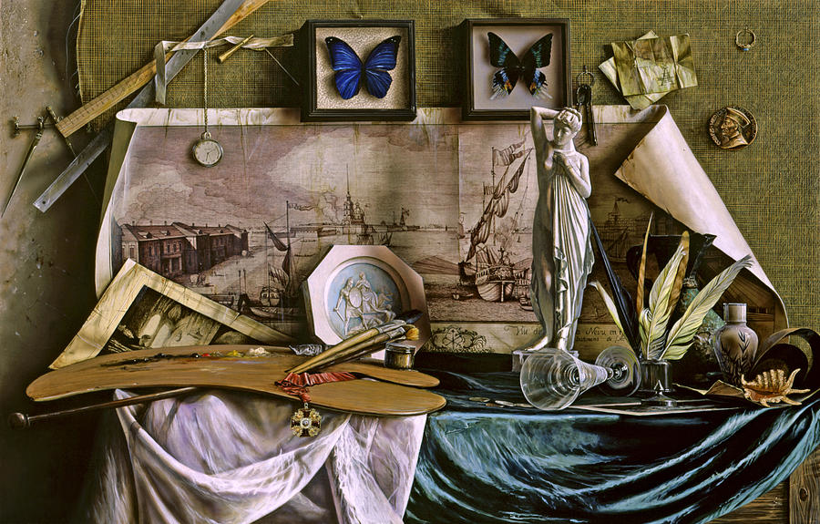
This desk belongs to someone. What can you tell me about them?
Oil Painting by Aleksandr Platonychev

Slide 4
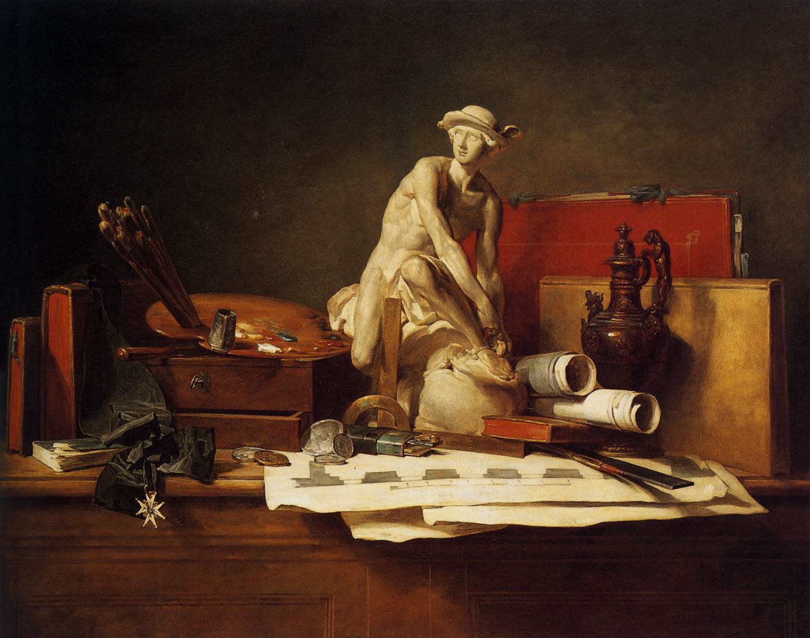
What can we tell about this subject?
Painting by Jean-Baptiste-Siméon Chardin

Slide 5
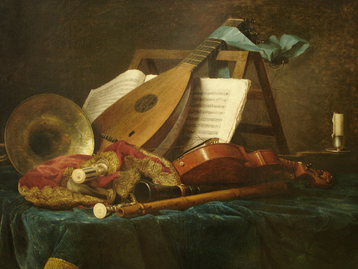
And this one?
Painting by Anne Vallayer- Coster

